Slide 1


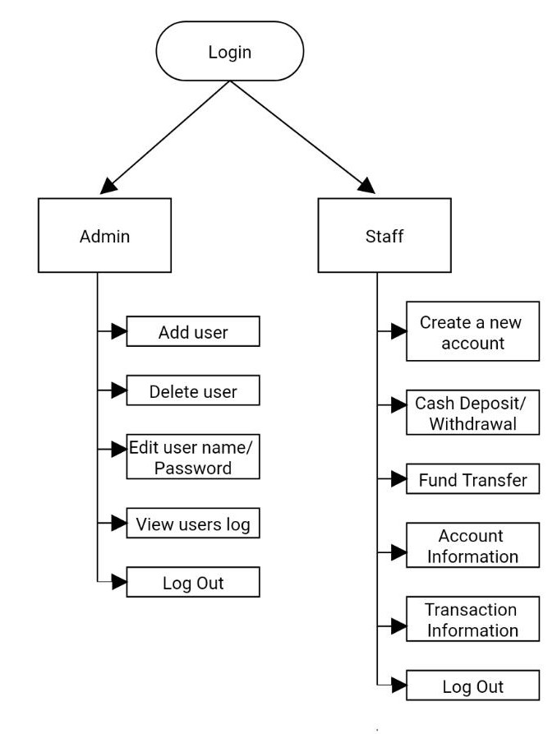
Inspark’19
An event of IIGNIS
Department of Information Science and Engineering
Project Title: Excalibur-Bank Management System
Team Members: Pranjal Prateek, Rishabh Kumar, Suyash Agrawal, Sarad Chhetri
Abstract/ Introduction
Methodology/ Architecture
Results
Conclusions
The Bank Account Management System is an application for maintaining a person's account in a bank. In this project I tried to show the working of a banking account system and cover the basic functionality of a Bank Account Management System through C programming . To develop a project for solving financial applications of a customer in banking environment in order to nurture the needs of an end banking user by providing various ways to perform banking tasks. Also to enable the user’s workspace to have additional functionalities which are not provided under a conventional banking project.
The program will be able to perform the following functions.
Administrator And Staff
Login/Logout.
Add/Delete Users (Staff).
Open New Accounts.
Cash Deposit, Withdrawal, Fund Transfer.
Check Balance, Account Details.
This project is developed to nurture the needs of a user in a banking sector by embedding all the tasks of transactions taking place in a bank.
Future version of this software will still be much enhanced than the current version. Thus the Bank Management System it is developed and executed successfully.
Objectives
To develop a software for solving financial applications of a customer in banking environment in order to nurture the needs of an end banking user by providing various ways to perform banking tasks. Also to enable the user’s workspace to have additional functionalities which are not provided under a conventional banking software.
References
https://en.wikipedia.org/wiki/Banking
www.w3school.com
www.udemy.com
www.geeksforgeeks.org/references-in-c/

